Slide 1
2024 Medicaid Statewide Provider Training
OHPA Prior Authorization

Slide 2
Mute
Video
Questions
Training expectations

Slide 3
Agenda
Prior Authorization (PA) team
PRISM
PA requirements
Criteria resources
PA Submission
Open question forum

Slide 4
Prior Authorization
(PA) team

Slide 5
Prior Authorization (PA) team
The prior authorization (PA) team is part of the Office of Healthcare Policy and Authorizations (OHPA) which is in the Utah Department of Health and Human Services (DHHS).
Comprised of staff including:
Registered nurses
Prior authorization review staff
There are currently 23 members on the PA team that review requests for 24 different programs.

Slide 6
Prior Authorization (PA) team
Functions:
Ensure safe, appropriate, and cost-efficient use of services for Fee for Service (FFS) members through the prior authorization process.
Collaborate with the medical policy team in the formulation of policy related to prior authorized services.
Addresses questions from clinical providers.
Refer cases for secondary medical review (medical consultants or Medical Review Committee) for prior authorization determinations.
Processed an average of 4,025 prior authorizations per month.
The PA team strives for a 7-day turnaround for all routine requests.
Receive an average of 311 phone calls per month.

Slide 7
PRISM

Slide 8
PRISM
Utah Medicaid replaced the Utah Medicaid Management Information System (MMIS) on April 3, 2023 with a new system PRISM (Provider Reimbursement Information System) for Medicaid.
PRISM is a cloud-based Medicaid management system.
Provides a single sign-on access to systems such as PRISM, the Eligibility Lookup Tool, and the Medicaid website.
Streamlines the prior authorization process with real-time access to decision summaries, documentation, and comments.
All requests requiring authorization are required to be submitted through the PRISM portal.

Slide 9
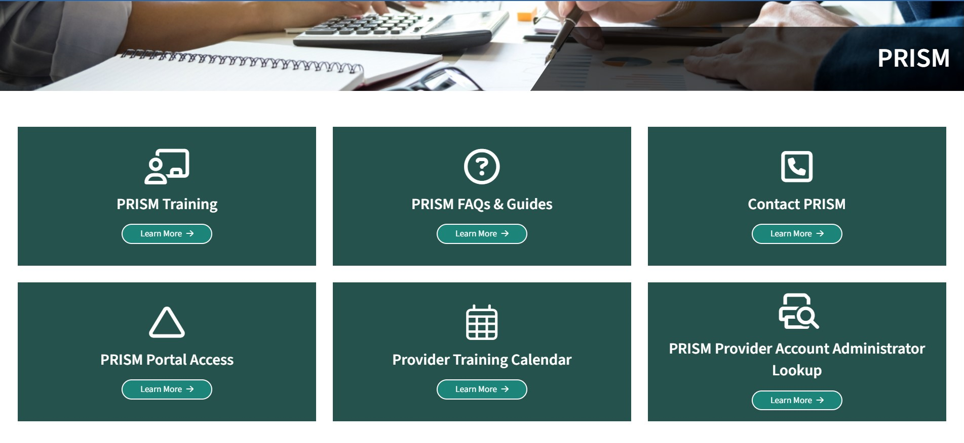
PRISM

Slide 10
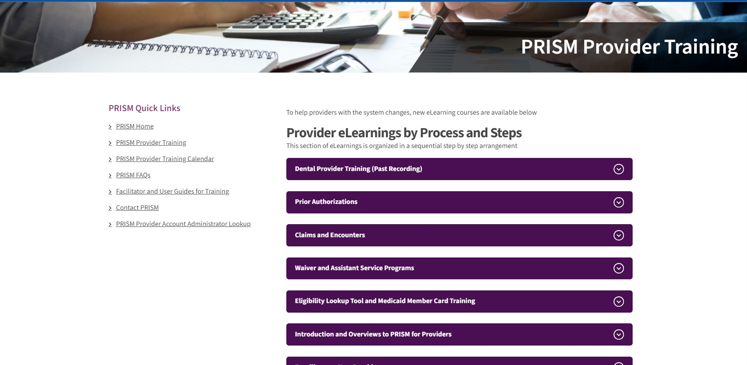
PRISM

Slide 11
PRISM
PRISM provider trainings and eLearnings are available on the Medicaid website:
https://medicaid.utah.gov/prism-provider-training/
Facilitator guides are also available on the Medicaid website:
https://medicaid.utah.gov/prism-faq/
Stay up to date on the implementation of PRISM through the Medicaid website and MIB articles:
https://medicaid.utah.gov/utah-medicaid-official-publications/

Slide 12
PA requirements

Slide 13
PA requirements
Check member eligibility
Member eligibility can be verified using the Eligibility Lookup Tool on the Medicaid website: https://elt.medicaid.utah.gov/EligibilityLookupTool/
The tool can also be accessed through the “External Links” in PRISM.
Member eligibility may also be looked up in PRISM under the “Member” tab.
Check codes being requested
Code coverage can be verified using the Coverage and Reimbursement Lookup Tool on the Medicaid website: https://health.utah.gov/stplan/lookup/CoverageLookup.php
The tool can also be accessed through the “External Links” in PRISM under “Fee Schedule”.

Slide 14
PA requirements
Upload only clinical documentation that is current and relevant.
Include all required documents, forms, and/or consents.
Include required modifiers (e.g. LL, RR, RT, LT, etc).
Please do not add a price to services requested in PRISM - only put a $0 in the field.
Manually priced items must include AAC (Actual Acquisition Cost) on Manufacturer's quote and price is entered by state.
Any changes needed to a request require a modification form.
Modification forms and all return documentation should be uploaded to ORIGINAL tracking number (PA request).

Slide 15
Criteria resources

Slide 16
Criteria resources
Medicaid website: medicaid.utah.gov
Provider manuals
Medicaid Information Bulletins (MIBs)
Coverage and Reimbursement Lookup Tool notes
Frequently Asked Questions (FAQs)
For specific criteria that can’t be found on the web or questions regarding prior authorizations, you may email: medicaidcriteria@utah.gov
Please allow for a 24-hour response time.
For policy related questions, please email: dmhfmedicalpolicy@utah.gov

Slide 17
Criteria resources
InterQual Transparency Tool
Allows providers to have access to a view-only version of InterQual criteria.
Can be found on the Prior Authorization Medical Criteria page: https://medicaid.utah.gov/utah-medicaid-criteria/
Or directly at: https://elt.medicaid.utah.gov/transparencytool

Slide 18
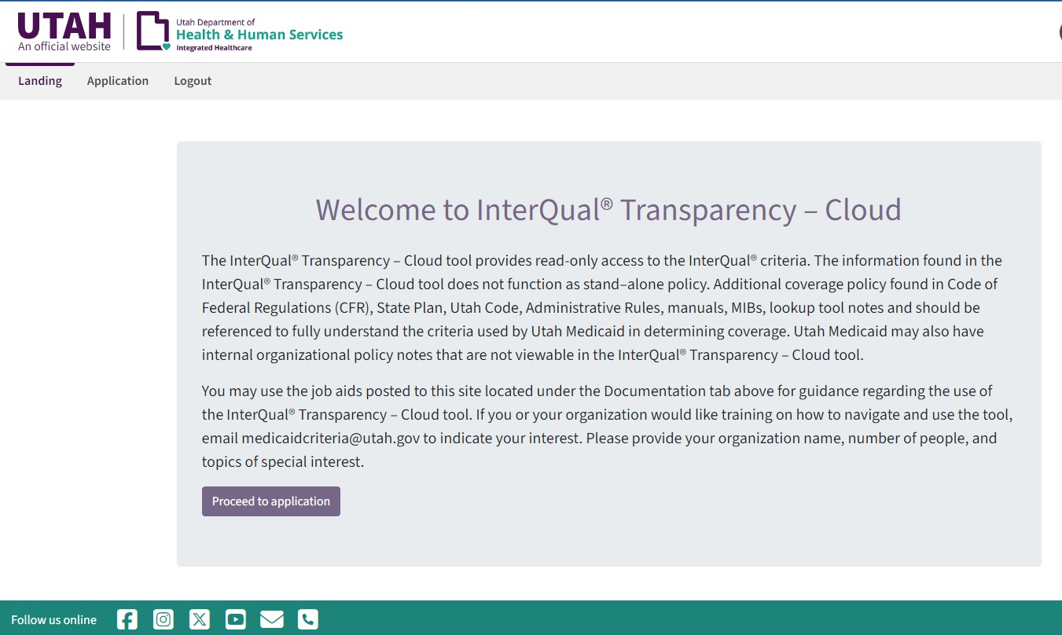
InterQual Transparency tool

Slide 19
PA Submission

Slide 20
How to submit a PA
All prior authorization requests are required through the PRISM portal.
If you do not have access to the PRISM portal, please contact providerenroll@utah.gov to get registered today.
Select the “PA” Tab, “PA request list” , “Add New Request”
Informational blurbs for providers attached to all correspondence or placed in comments section.
Submit only requests for Fee for Service members or carve-out services.
Provide contact information for a person who can speak on behalf of the PA request (not generic information).

Slide 21
Tips and tricks
Notifications: You will receive notifications for all status changes and determinations on submitted requests.
View notifications from your “My Inbox” tab.
Correspondence letters / documentation: Found in each tracking number under the “paperclip” in upper right corner. These can be printed anytime.
Comments: Communication directly with reviewer/state staff within the “bubble” icon in upper right corner of each tracking number.
Hospice: All admission records require new CTI upload every 60 days to extend the benefit. Enhance rates must align with hospice initial admission to agency.

Slide 22
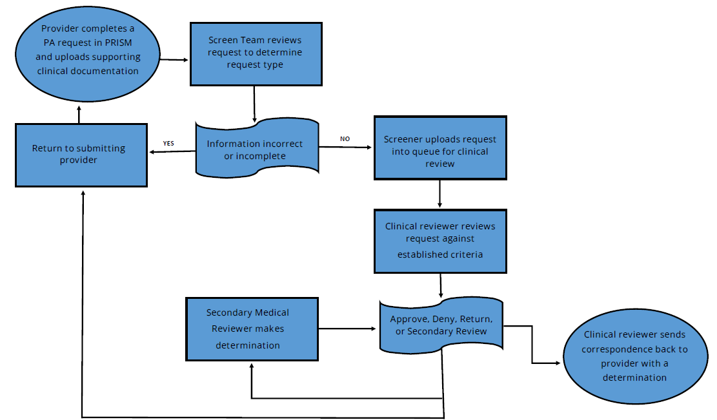
Prior authorization process

Slide 23
What happens to my request?
Approved or Denied
Returned
Clinical - You will receive notification of return letter addressing what clinical documentation is missing.
Upload new documentation to the tracking number that was provided on the return letter. Access this under the “PA” tab and then go to “PA Request List”.
Please do not create a duplicate or new entry for a return.
Address every issue that was mentioned in the return letter.
No action or cancelled
No action - Requests that do not require any action by the PA team (e.g. code does not require prior authorization or member is not eligible for Medicaid).
Cancelled - Requests that provider would like to be withdrawn or if the request is a duplicate.

Slide 24
Questions

Slide 25
Questions?
ABA therapy billing
Codes must contain modifiers for provider type on 97155 and H0032.
PT/ OT - See 20 visit allowance prior to PA requirement on CR&L tool
Code modifiers GP(PT) & GO(OT) must be included to differentiate type of therapy.
What hospital facility DME items are covered by Medicaid and what documentation is required?
Utilize the CR&L tool and DME manual for specific requirements.
For any prior authorization request that is approved and a member switches benefits mid-authorization to return back to FFS, no resubmission or additional request will need to be submitted. Authorization is valid for the full period stated on the approval. It is the provider’s responsibility to check eligibility prior to billing.
Notes:
Continuous editing based on submitted questions with registration.

Slide 26
Contact us
You may reach prior authorization staff by calling (801) 538-6155 or toll-free 1-800-662-9651 and select option 3, option 3, and then choose the appropriate number for the program you are calling about.
You may also email PA questions to: medicaidcriteria@utah.gov

